Slide 1
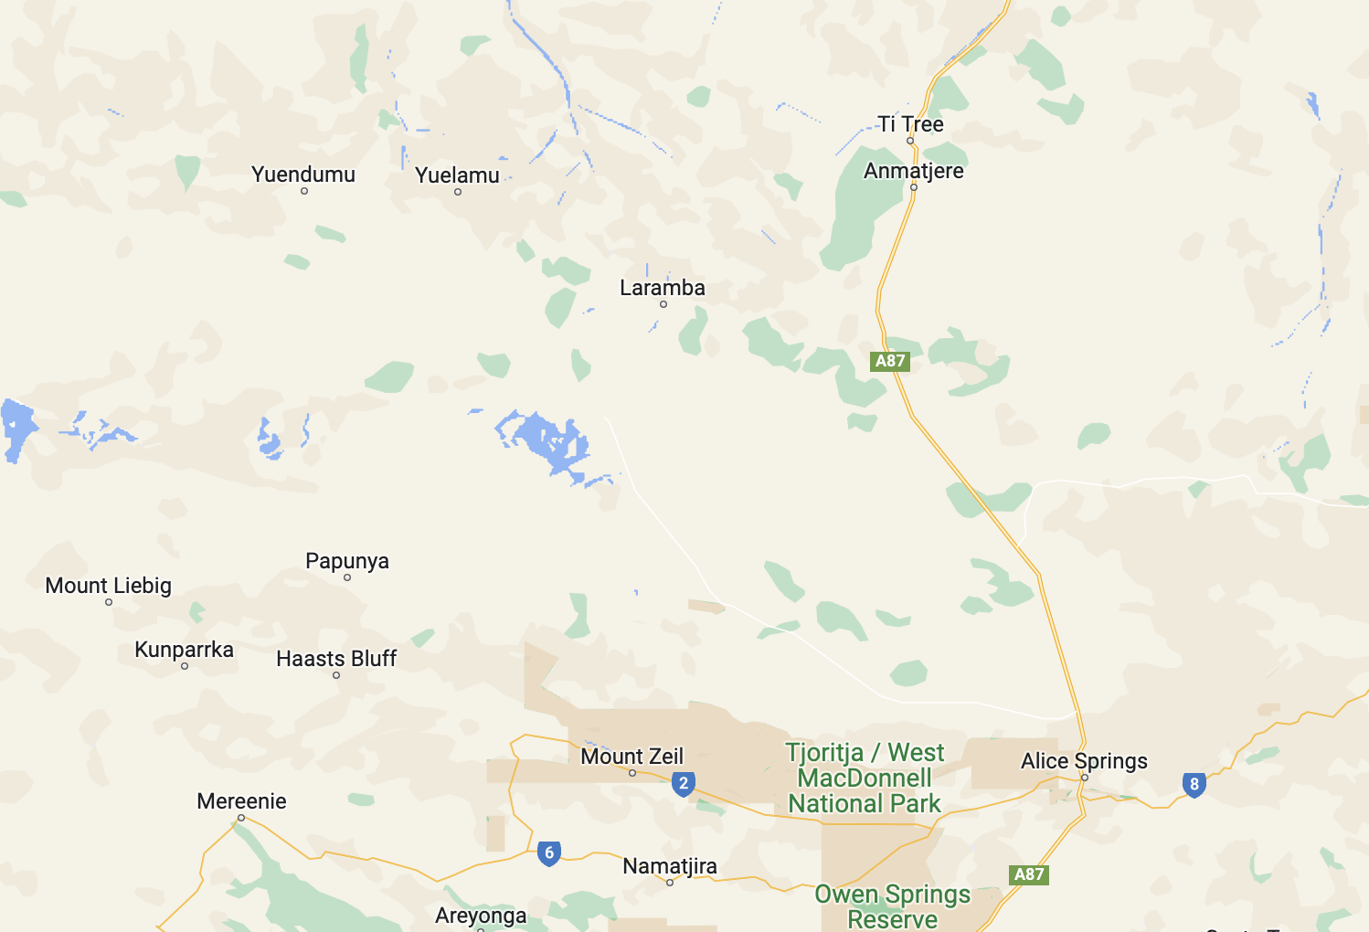
group4
Township – Yuendumu, Tanami Desert, NT
People/Community – Warlpiri and Anmatyerr
Population – 700 to 800
(Beavan 2019)

Slide 2
Problem
Water Scarcity and Quality
Water Sources
White water
Provide purified water using renewable energy
Formed ideas in respect to: Access & Equity, Health & Safety, Appropriateness, Affordability, Environmental Heath, and Sustainability

Slide 3
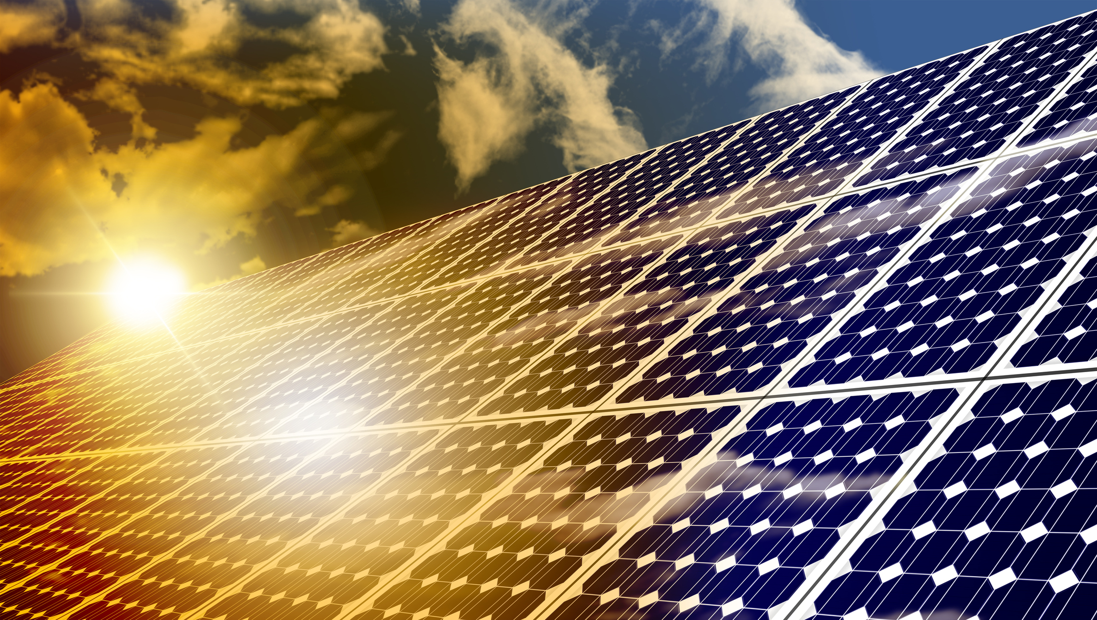
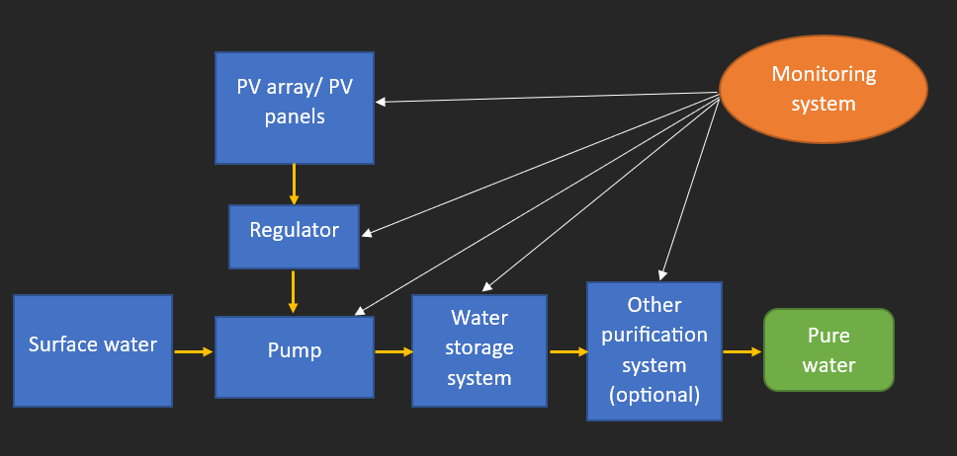
Design idea 1
Used technologies/devices
Photovoltaic (pv) panels – trung kien nguyen
1. PV panels: Capture sunlight and convert it into electricity through the photovoltaic effect
2. Regulator: Regulate and control the flow of electricity from the PV panels to ensure efficient power management
3. Raw water
4. Purified pump and water storage: made from friendly-to-fresh-water materials, pump has the ability to purify using heat & electricity
5. Intelligent Monitoring/control system: It is responsible for monitoring and controlling the operation of the water pump and filtration system, using AI and IoT technologies
Purify with heat

Slide 4
Three different approaches
► Feasibility and System Sizing: Assessing the viability and suitability in some specific location in the Yuendumu Indigenous Community (Northern Territory – Australia)
► Component Selection and Integration: Selecting the necessary components, and integrating to form a efficient system (experts’ management)
► Installation, Operation, Monitoring, and Maintenance: this approach focuses on the effective operation, monitoring, and maintenance of the whole system (focus in the local people training).

Slide 5
benefits
IMPACTS
♠ Local access to Clean and Safe Water
☺ Health and Well-being Improvement
♣ Sustainable and Renewable Energy Source
☻ Increase local living standards, number of jobs, incomes, and technical skills in the township
♦ Cost-Effective Operation (<= 5m AUD)
♥ Independence from Grid Infrastructure
Constraints
€ Initial Investment
¥ Maintenance and Repairs
£ Technical Expertise

Slide 6
Ultrafiltration (UF) and reverse osmosis (RO) membrane using solar energy
-Truong Pham Tuan Nguyen-
Solar: Capture energy and convert to electricity.
Pump: Using electricity to pump water through system.
UF Membrane: uses a semi-permeable membrane with larger pores to remove particles, colloids, and some larger molecules.
RO Membrane: a more advanced filtration process that uses a semi-permeable membrane with much smaller pores to remove dissolved salts, minerals, and other contaminants.
Storage Tank: Preserve steady supply.
Tap or Distribution System: Distribute to users.
Tap or Distribution System
Solar panels
Pump
UF Membrane
RO Membrane
Storage Tank

Slide 7
Three different approaches:
Assume that solar energy is used for the whole system.
Analyst: The UF membrane acts as a physical barrier with relatively larger pores, typically in the range of 0.01 to 0.1 microns.
Assess the cultural appropriateness in the Yuendumu township, including noise, cost, employment.
Technologies and Devices used:
Membrane modules.
Pressure vessel.
Pump.
Control System.
Sensors.
Piping.

Slide 8
Benefits:
Versatility: RO membranes are applicable to a broad range of applications and industries since they may be used for a number of water sources, including saltwater, brackish water, and wastewater.
Retention of Essential Minerals: UF membranes frequently retain important minerals like calcium, magnesium, and potassium while removing larger pollutants. This is especially helpful for treating drinking water or creating food and beverages, both of which depend on maintaining the mineral composition of the water
Potential Impacts:
Reusing water and recovering resources:
Environmental impact
Constraints:
Water quality is limited
Costly

Slide 9
Design: 3 What is Gravity-Fed Water System?
Gravity fed water supply using solar energy is a sustainable and environmentally friendly way to provide water for homes, farms, and other applications. The system uses solar energy to power a pump that moves water from a source such as a well or a stream to a storage tank, which is located at a higher elevation than the point of use. The stored water is then gravity-fed to the point of use, eliminating the need for electricity or fuel to power the pump.

Slide 10

Technologies used-
Approaches:
Direct Solar Pumping
Solar-Powered Battery System:
Solar-Powered Reverse Osmosis System
Storage
S
P
The basic technologies and devices of a gravity-fed water supply system using solar energy are
a solar panel
a battery
a water pump
Gravity

Slide 11
Benefits:
Uses renewable and sustainable source of energy that reduces dependence on fossil fuels.
Low-maintenance system that does not require much upkeep once installed.
Can provide water even in remote areas where there is no access to grid electricity.
Constraints:
The amount of solar energy available can vary depending on the season and weather conditions. In some cases, this can impact the reliability of the system, especially during periods of low sunlight.
To ensure that the system provides sufficient water supply, it is important to accurately size the components of the system, including the solar panels, battery storage, and water storage tank. This can be a challenge in some cases, particularly in areas with variable water demand.

Slide 12
Impacts:
A solar-powered gravity-fed water supply system can be more cost-effective than traditional water supply systems that rely on grid electricity or diesel generators.
It is a renewable energy solution that can reduce reliance on fossil fuels and lower greenhouse gas emissions. This can have environmental benefits for the local community and contribute to Australia's efforts to maintain a low-carbon economy.
By providing clean drinking water, a solar-powered gravity-fed water supply system can improve public health outcomes, reducing the incidence of waterborne diseases and improving the overall health and safety of the community.

Slide 13
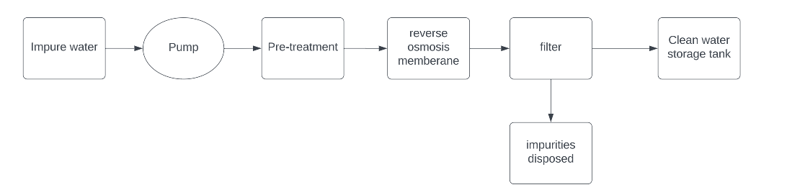
REVERSE OSMOSIS SYSTEM (WIND ENERGY) - Nuyang Rai
Flowchart of how the system works
Impure water is pumped from the river.
Pre-treatment components are added in the impure water
It is pushed through the RO membrane with the help of high-pressure pump powered by wind turbine.
Filtered again where the impurities are dumped and clean water is stored.
Wind turbine
High pressure

Slide 14
Three different approaches:
Research and Concept Development: we conduct research and explore various concepts and technologies such as, studying existing reverse osmosis system, how the filter works and different types of treatment components.
System Integration and Engineering: this is to make sure everything functions properly and efficiently by taking factors into consideration.
Prototyping and Testing: this approach is to identify any design flaws and make necessary adjustments.
Technologies and devices used:
Reverse Osmosis (RO) membrane
High-Pressure Pump
Pre-treatment and Post-treatment components
Wind turbine
Control Panel

Slide 15
Benefits
Improves public health
Reduces the need to purchase bottled water
Improves taste of the water
Potential Impacts
Regular maintenance needed
Uses a lot of water
Constraints
Costly
Fluctuation

Slide 16
 | Design 1 | Design 2 | Design 4 | Design 5
Approach 1 | 2.5/3 (Assess) | 2/3 (Predict) | 3/3 (Execute) | 2/3 (Research)
Approach 2 | 2.5/3 (Integrate) | 2/3 (Analyst) | 2/3 (Execute) | 2/3 (Integrate)
Approach 3 | 2/3 (Operate) | 3/3 (Assess) | 2/3 (Execute) | 2.5/3 (Test)
Design guidelines
Guideline 1: Access and Equity | 2.5/3 | 2/3 | 2/3 | 2.5/3
Guideline 2: Health and Safety | 3/3 | 2.5/3 | 2/3 | 2.5/3
Guideline 3: Environmental health | 2.5/3 | 3/3 | 3/3 | 2.5/3
Guideline 4: Affordability | 3/3 | 2.5/3 | 2/3 | 2.5/3
Cultural appropriateness | 2.5/3 | 3/3 | 2.5/3 | 2/3
Total | 20.5/24 | 20/24 | 18.5/24 | 18.5/24

Slide 17
References
‘[Town of Yuendumu]’ [image]’, in Beavan, K 2019, Yuendumu in Central Australia at 'severe risk' of running out of water, abc, viewed 16 May 2023, <https://www.abc.net.au/news/2019-08-13/remote-community-yuendumu-running-out-of-drinking-water/11405024>.
Australian Bureau of Statistics 2021, Yuendumu, viewed May 16 2023, <https://abs.gov.au/census/find-census-data/quickstats/2021/SAL70301>.
Beavan, K 2019, Yuendumu in Central Australia at 'severe risk' of running out of water, abc, viewed 16 May 2023, <https://www.abc.net.au/news/2019-08-13/remote-community-yuendumu-running-out-of-drinking-water/11405024>.

